Slide 1
Predicting Air B&B Listing Prices
Thomas McMahon

Slide 2

The Problem
When I comes to going on a trip the question always comes up of where am I going to stay. In recent years there have been many companies trying to cash in on this problem, but one is letting everyday people become the solution themselves. This is through the power of Air B&B and it has been bringing homeowners and renters togther for short term rentals together for years now, but the question has become did I get a good price on the rental.

Slide 3
Who Cares
The people that are going to care about this project are going to be the people that are looking to make money by renting out their property using Air bnb, by making sure they are getting a good price for their space while staying competitive, as well as the customers that are trying to plain their trips by figuring out about how much they should expect to spend on housing and if the specific listing is the right one for them.

Slide 4
Data Information
The data used was from rental listing in New York City in 2018
The number of listings in the dataset was 36923
The data was from http://insideairbnb.com/get-the-data.html

Slide 5
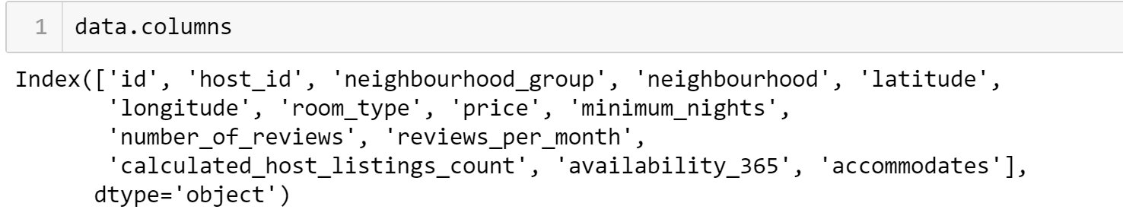
Cleaning the Data
When it came to cleaning the data the biggest issue was determining how to fill the null values, and more importantly if some of those features actually would help the model make predictions. A great example of this was
the feature of last review. The columns had over two thousand missing values, the exact number matched the number of times that the column number of reviews was equal to zero. This was an easy one to fix filling all of the null values with zeros, but the question still stands does the time of the last review really matter when it comes to the listing price on an Air BnB. I decided it did not and ultimately removed the column to reduce noise in the model.

Slide 6
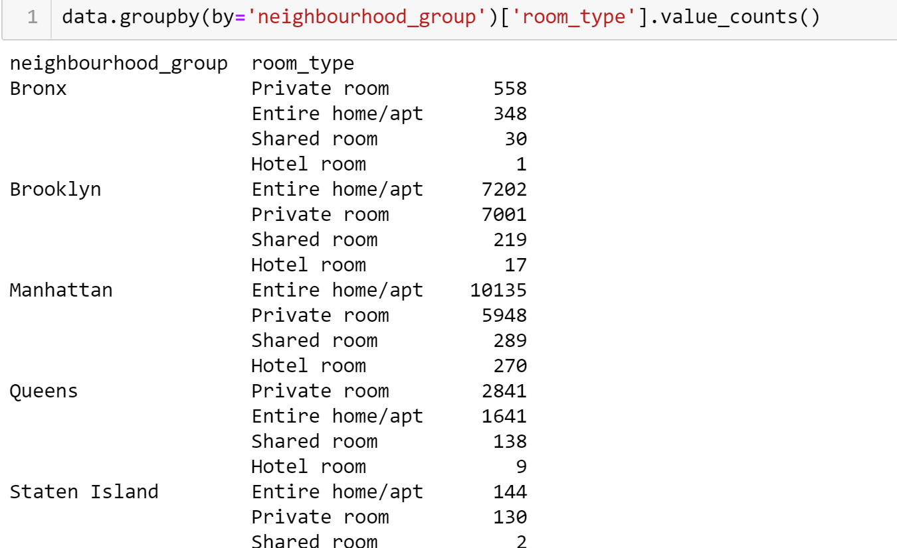
Looking For Trends
Once I had the features that I thought was relevant I started trying to find trends between the features. Some of what I was looking for was to see if any of the features could be broken down by other features, and to see if this information had any meaning. For example I wanted to look how many listings were there for each different type of room in each borough. The purpose for this is to make sure that both features had enough data points across both of the features that the model would have enough to learn and predict vs having too little data points that could lead to the model using a feature that didn’t have enough points and caused an increase in bias towards that feature

Slide 7

Feature Reduction
Before I could model the data I needed to continue to make sure that I did have any features in the dataset that could cause noise in the predictive model. I went through and thought about what features were truly relevant when it comes to the price of the listing. I settled on the borough, the neighborhood, and the amount of people the listing could accommodate.

Slide 8
Modeling Overview
The models were build using Supervised learning
Because I was looking for the price of an individual listing the models were regression models
I used scikit learn inside python to build the models

Slide 9
Modeling Types Used
I build both linear regression models and random forest models .
I used linear regression models because I felt that with th limited amount of features used in the predictions that it wouldn’t be to complicated for the model to predict.
I then used random forest regression because it gives me the ability to make dozens of decision trees and have the ability for the model to learn from each tree to become a better predictor.

Slide 10
First Models
The results for the first set of models was very troubling. I used a linear regression as a baseline because I didn’t have that many features in the model that I felt that it wasn’t too complicated for a linear model. But when I ran the model the main score I was using to evaluate the model, mean absolute error, had a value of over one thousand. This meant that on average the prediction was off by over a thousand dollars. I though that the model might have been more complicated than I thought so I decided to run a random forest regression model. The results of that model were better, but not by nearly as much as I would have liked. At that point I new that I needed to go back to the drawing board and rework my feature engineering, and exploratory data analysis.

Slide 11
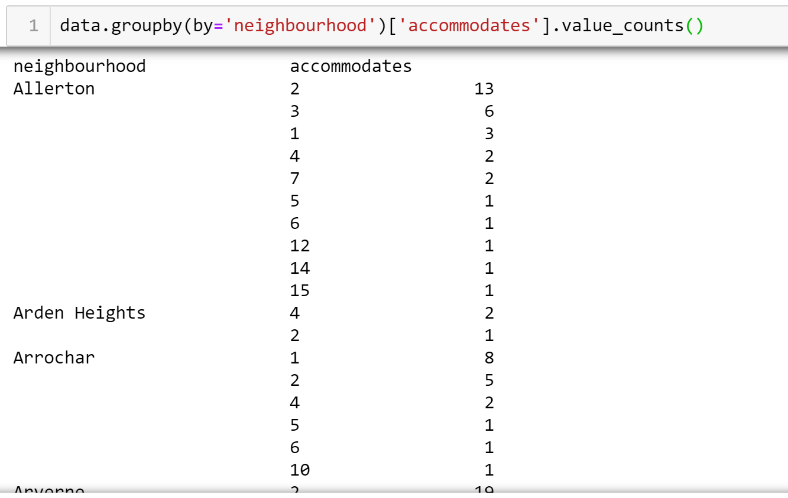
Reworking Features
When I was going back through all of my features, I found what I though was the problem. The feature of the specific neighborhoods that the listings were located had a decent amount of total values, but not a lot of listings that accommodate the same number of people. This was what I believed was causing the issue by having the model use the specific neighborhood it caused there to be heavy bias to the little data that was available to be train on. Once I figured this out I removed the feature and remodeled the data.

Slide 12
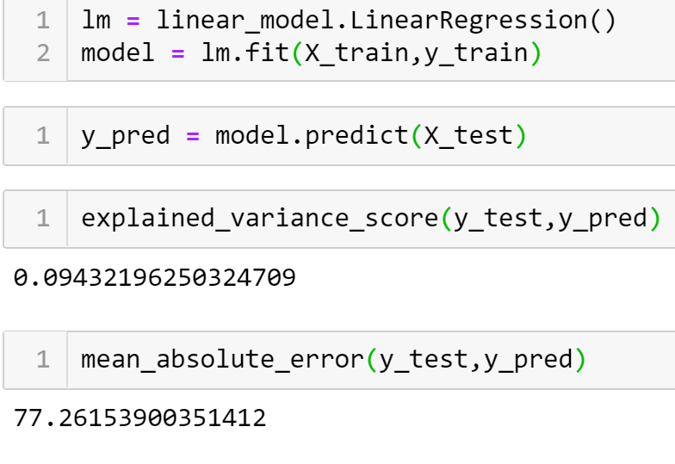
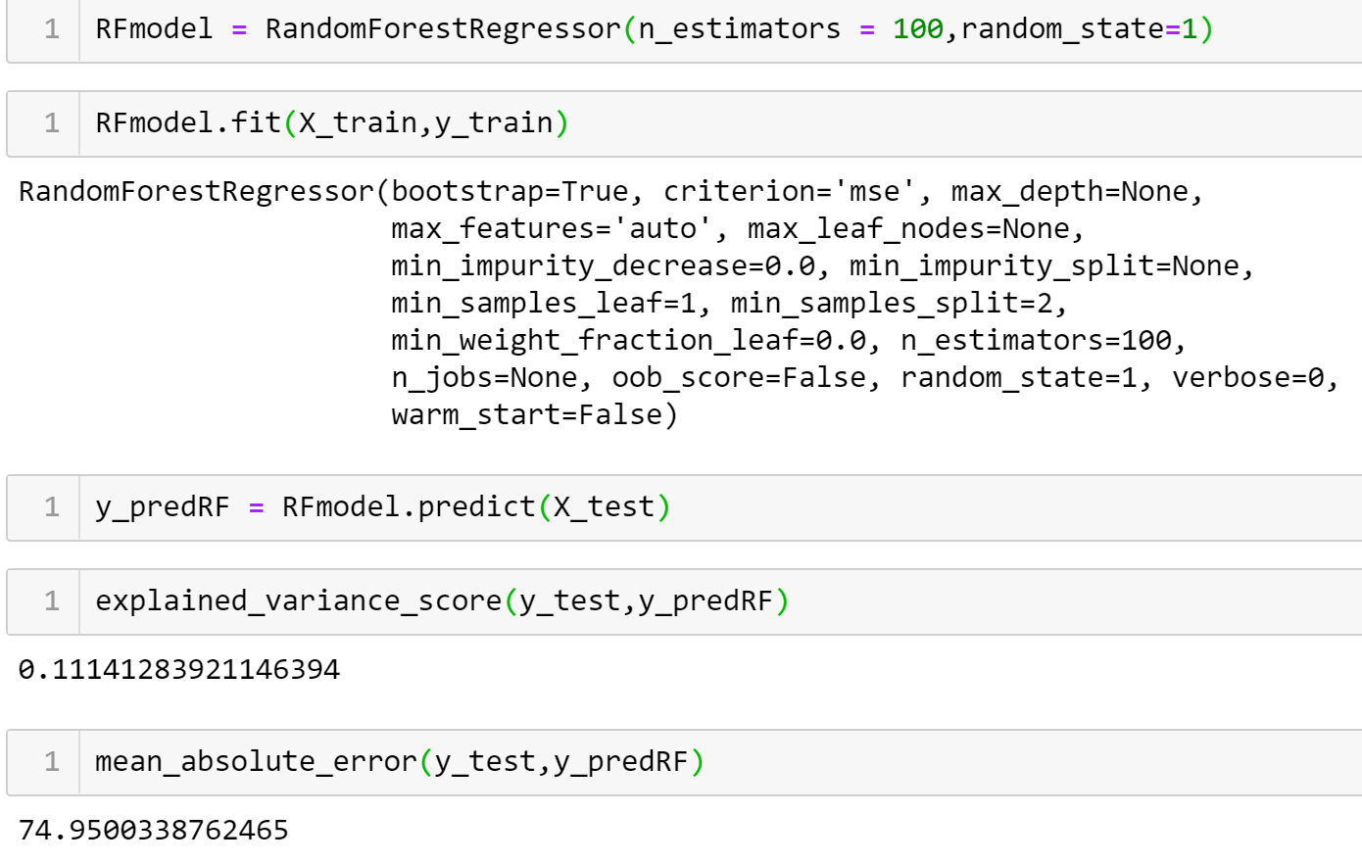
Models Take 2
Now with only the boroughs, number of people that the listing accommodates, and the price as the data points it was time to remodel the data. First when I used the linear model the results I got were much more promising. My mean absolute error dropped dramatically to just over $77. I still felt that this was too high so I I ran the random forest model again and again got only slightly better results. The random forest model gave me a mean absolute error of just under $75 dollars. I still wanted to see if I could improve on the results so once again I went back to the features.

Slide 13
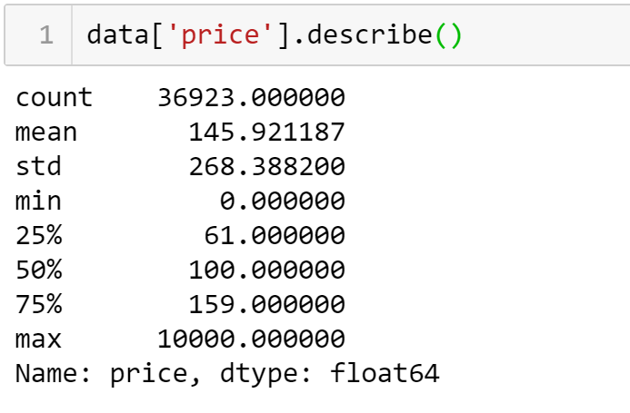
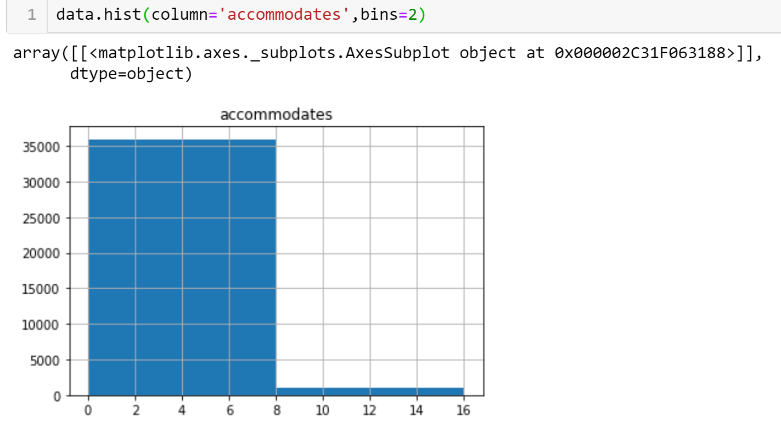
How to Improve the model
I wanted to figure out why I still have a pretty high error so I went back and looked at the dataset, and the issue was that in the higher range there are less data points of listings that can accommodate more than 7 people and the prices of those listings were significantly higher than the listing price of the other listings. The max price of the listings was $10,000/ night with a standard deviation of $268. With this in mind I knew that models were doing a good job of making the predictions, but wanted to do more to se if I could make the model better. What I wanted to see was if I separated the listings with the much higher than average amount of people able to be accommodated and focus on more similar listings if I could make the model better. To do this I needed to find the number of people that caused the huge shift. The way I did this was by plotting a histogram of the number of listings that could accommodate each different number of people. When I did this I found that the number where the drop off occurred was at 8.

Slide 14
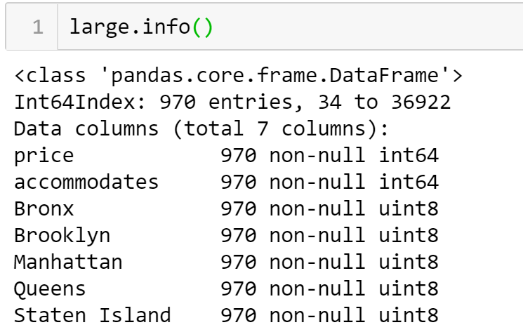
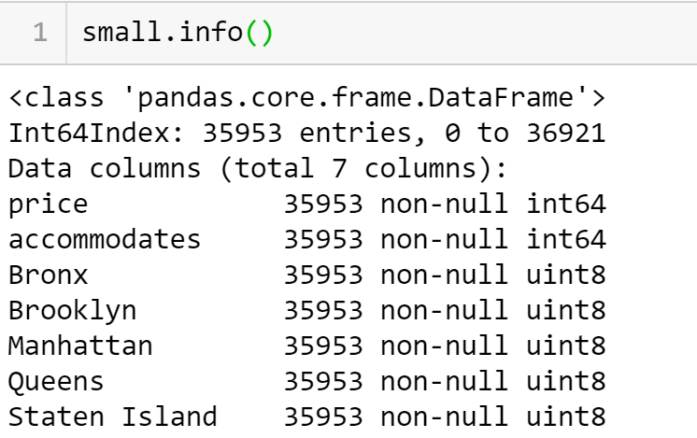
New Datasets
From what I learned about where the drop off in datapoints was I decided to make two new datasets. One with all of the listings that accommodate 8 or more called large and a dataset with the rest called small. When I was looking at the size of the datasets I found that the large dataset had less than 1000 datapoints. This is not nearly enough to make an accurate prediction but I decided to run the model to see if it could surprise me. But more importantly I was looking to see if pulling thoses large listings out of the dataset would improve the predictions on the small dataset.

Slide 15
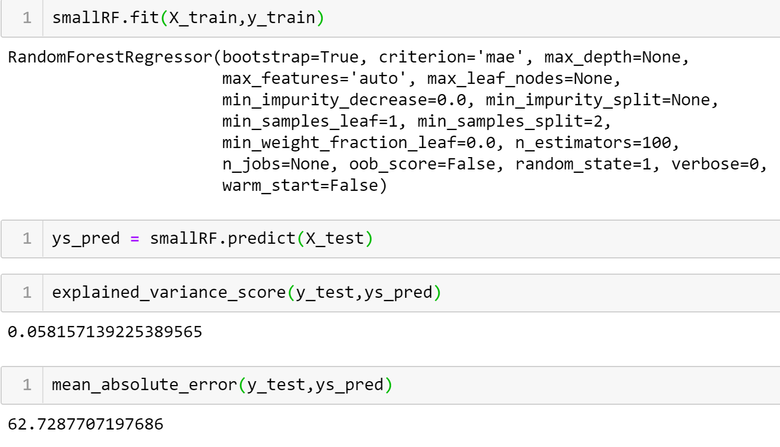
Last Models
As I expected the lage dataset preformed much worse than the dataset as a whole with a mean absolute error of over $280, but I carried more about the changes on the small dataset. I was very happy to see that the mean absolute droped almost 20% down to just over $62. This showed that with enough datapoints the model was able to predict with fairly good accuracy the listing price for an Airbnb listing.

Slide 16
Conclusion
In the end I was able to with just a few features build a model that could predict the price of an Airbnb listing in New York City. This model will be able to be used by both owners and customers to make sure that they are getting a fair price when renting on Airbnb.

Slide 17
Possible Improvements
The biggest thing that could help the dataset is getting a higher volume of listings that can accommodate a large group of people. Another future improvement could be creating more groups of data to be able to find the price for a more precise number of people that need to e able to stay in each listing.

Slide 18
Thank you
Any Questions?

